Slide 1

Analog Computer
Outlaws

Slide 2
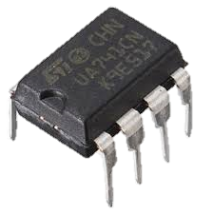
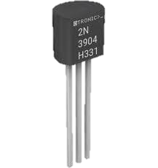
Component Selection Justification
UA741 Op-Amp:
Availability & Cost: Widely available and affordable.
Simplicity: Ideal for basic operations like addition, subtraction, and integration.
Frequency Response: Bandwidth (~1 MHz) is sufficient for 1 kHz to 10 kHz signals.
Ease of Use: Stable and easy to implement without complex compensation.
2N3904 Transistors:
High Availability & Low Cost: Commonly available, low-cost NPN transistors.
Frequency Response: Transition frequency of ~300 MHz easily handles 1 kHz to 10 kHz operations.
Versatility: Suitable for various analog applications, including the Gilbert cell multiplier.
Low Power Consumption: Minimizes heat dissipation, ideal for compact analog circuits.

Slide 3
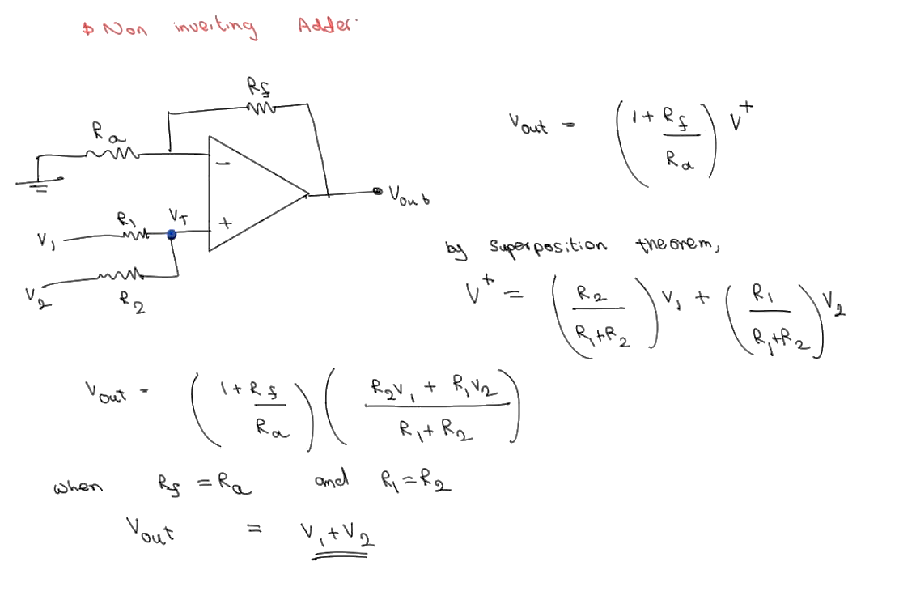
Non-Inverting Adder

Slide 4
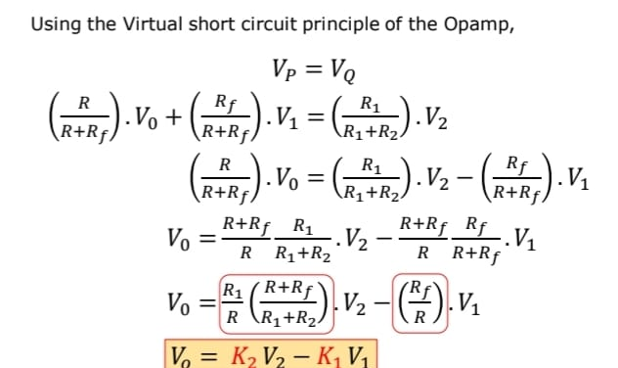
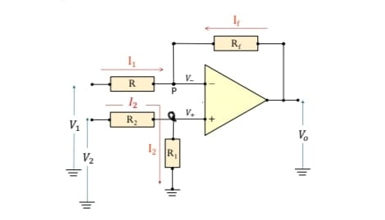
Subtractor
Choosing all the resistors as 1kohm, we get
Vo = V2 – V1

Slide 5
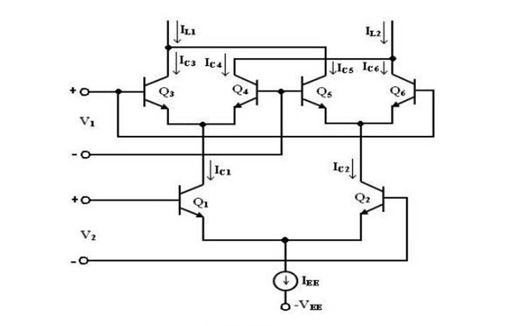



Gilbert-Cell Multiplier
The collector current of Q3 and Q4 are given by
The collector current of Q3 and Q4 are given by
The collector current IC1 and IC2 of transistors Q1 and Q2 can be expressed as

Slide 6
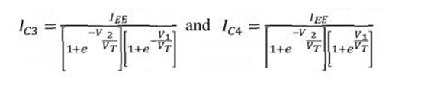
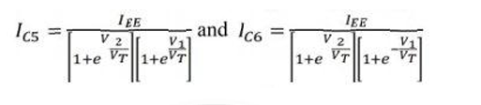
Gilbert-Cell Multiplier ctd.
Substituting the above equation in IC3 and IC4, we get
Substituting the above equation in IC3 and IC4, we get

Slide 7
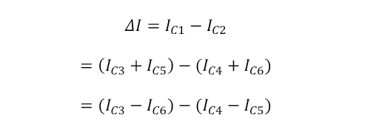
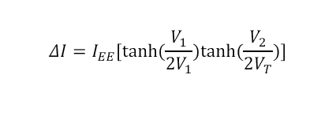
Gilbert-Cell Multiplier ctd.
The differential output current I is given by
Substituting the above equations and it employ exponential formulae for hyperbolic functions, we get

